Slide 1
SMART DRAINAGE SYSTEM
USING IOT
BY-
Satish Kumar

Slide 2
PROBLEM STATEMENT
Today's drainage system is not computerised. So whenever there is blockage it is difficult to figure out exact location of the blockage. Also we don’t get early alerts of the blockage. Hence detection and repairing
of the blockage becomes so time consuming. It becomes very inconvenient
to handle the situation when pipes are blocked completely.
due to such failure of drainage line people face a lot of problems.

Slide 3
OUR SOLUTION
Required changes in the system –
Detect the location
Prior information of the blockage
Design of SMART DRAINAGE SYSTEM.
System governing the flow of sewage from the pipes.
Use of flow sensors to detect the variations in the flow.
Collect the database.
Get the prior alerts of blockages and locate them using IOT

Slide 4
Technology
IOT
flow sensors at different locations will collect information of sewage flow through that node and send it to the central system which will generate alerts handful of time before complete blockage.
Data base management system
it will contain the generalised data for different time instance with which the data received from the flow sensors will be compared to generate the alerts.

Slide 5
Unique selling point
Alerts will be generated when the blockage just starts developing .
Time available to repair the blockage will be enough to prevent the drainage line from completely shutting.
This idea will also help in detecting the leakages.
This technology can be used for all fluid carrying systems. (e.g. Water pipes, gas pipelines)

Slide 6
Market size
All metropolitan and developing cities.
Companies dealing with fluid carrying systems.
Government (civil departments)
Water plants
Gas supplying agencies

Slide 7
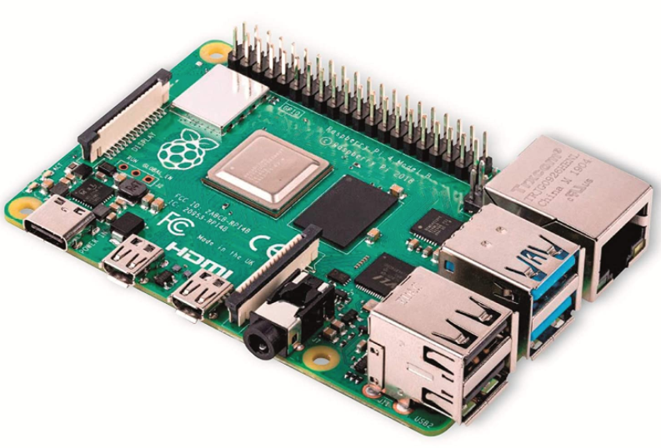
Raspberry Pi
The Raspberry Pi hardware has evolved through several versions that feature variations in the type of the central processing unit, amount of memory capacity, networking support, and peripheral-device support.

Slide 8
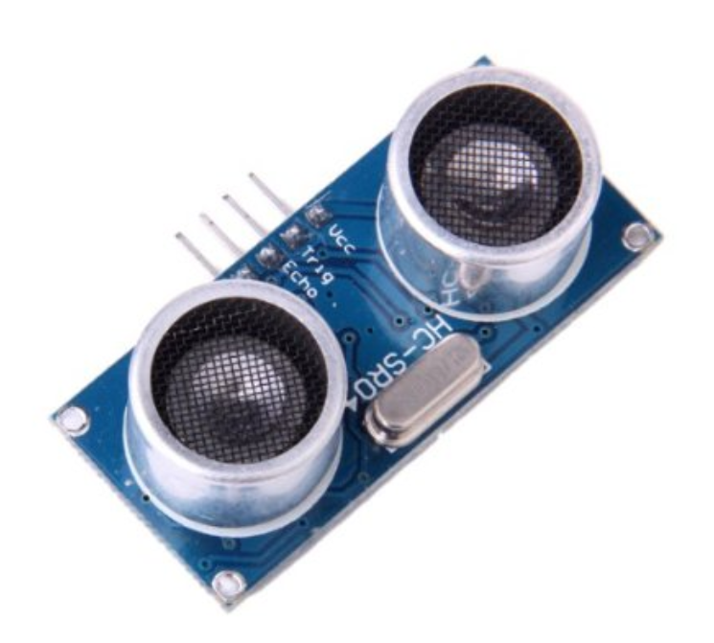
Ultrasonic Sensor
An ultrasonic sensor is an electronic device that measures the distance of a target object by emitting ultrasonic sound waves, and converts the reflected sound into an electrical signal. Ultrasonic waves travel faster than the speed of audible sound

Slide 9
FLOW SENSOR
Mass flow sensors are widely-used to control the exact dosing of gases or liquids in many technical systems. The size of the sensor is adapted to the diameter of the pipe through which the fluid or gas is transported. Small diameter tubes make it necessary to use miniaturized sensors which are usually fabricated by exploiting silicon technology.

